Slide 1

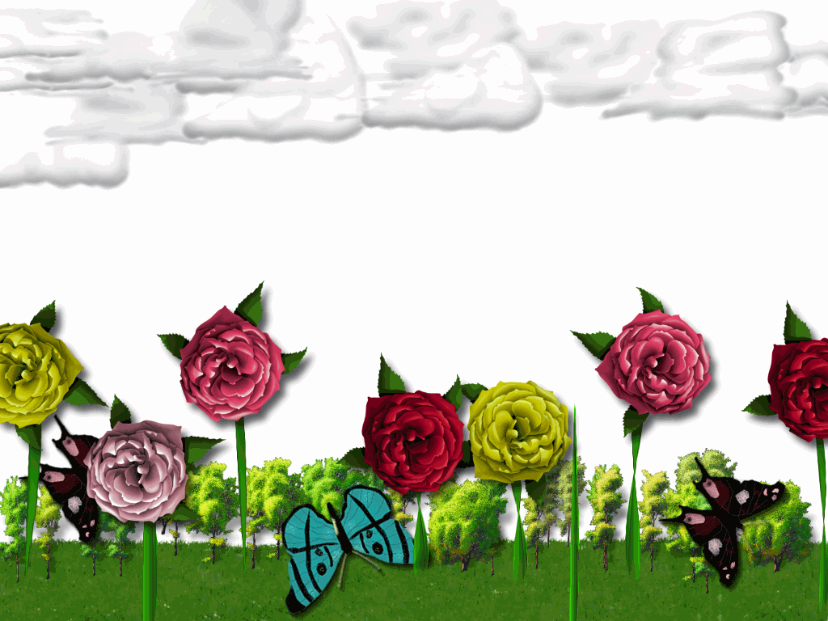


Slide 2

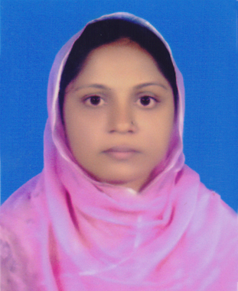
Identity of the presenter and class-
Sub:English 1st paper
Class:Nine
Selina Akter
Ass.Teacher(English)
Bohodder kata high school
Chakoria,coxs bazar
Phone:01815-851776
Email:selikamal8485@gmail.com

Slide 3
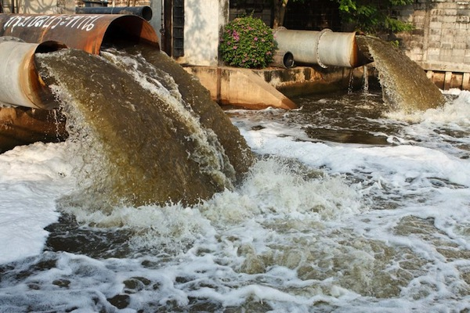
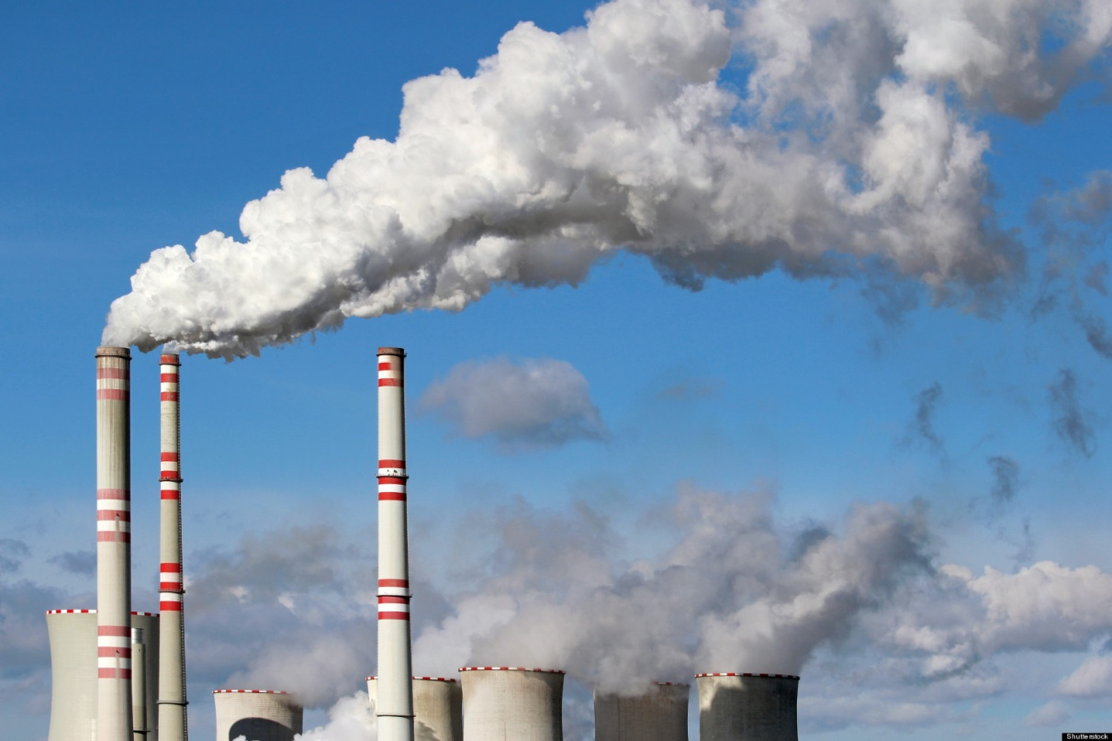
Lets see some pictures-
Industrial smoke is mixing with air
Polluted water is mixing with river

Slide 4
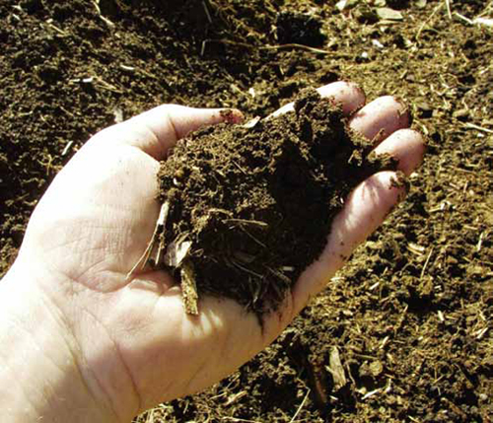
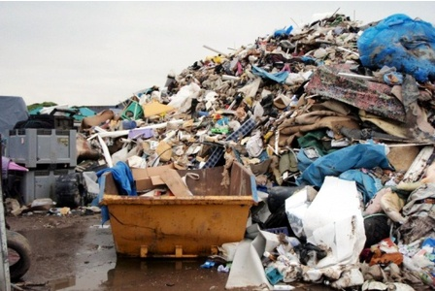
Look at the picture bellow-
Mismanagement of Rubbish
Soil pollution

Slide 5

Our todays lesson is-
Environmental Pollution
Unit:5
Lesson:2

Slide 6
Learning outcomes
By the end of the lesson, we will be able to-
ask and answer questions;
read and understand text through silent reading;
Write short paragraph.

Slide 7
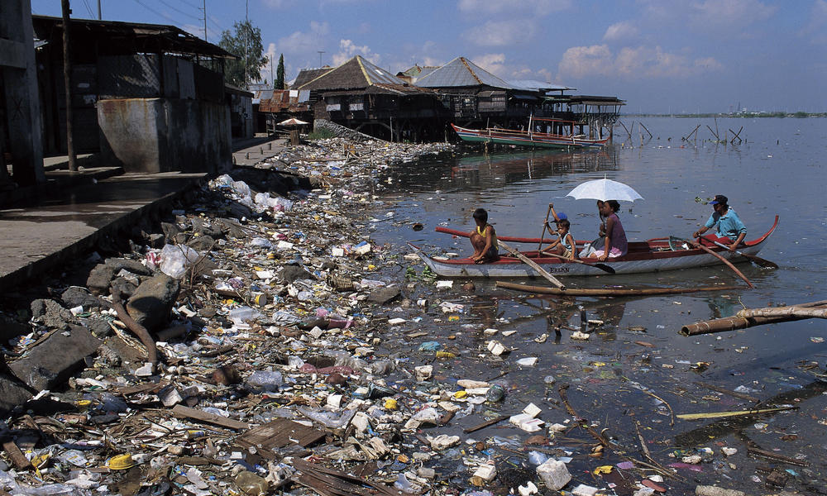
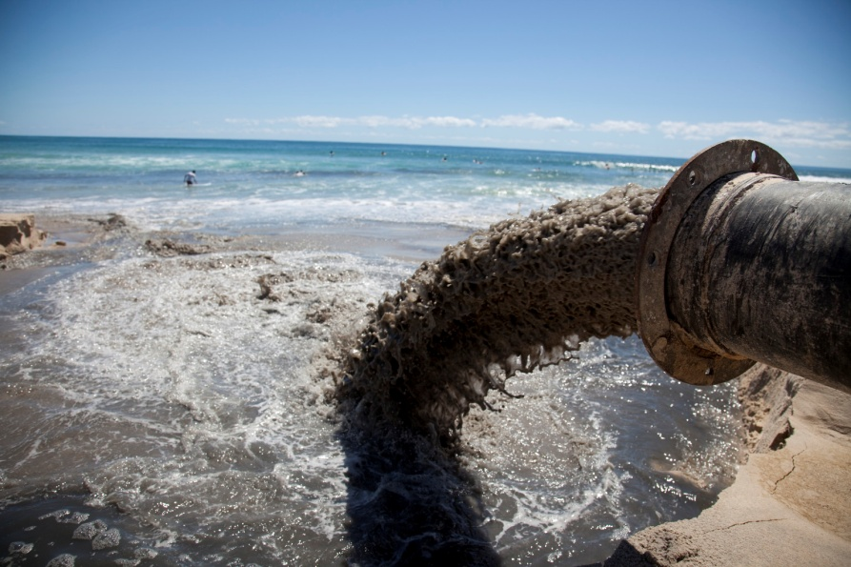
New vocabulary
Pollution
To make something ugly
Emission
Sending out

Slide 8
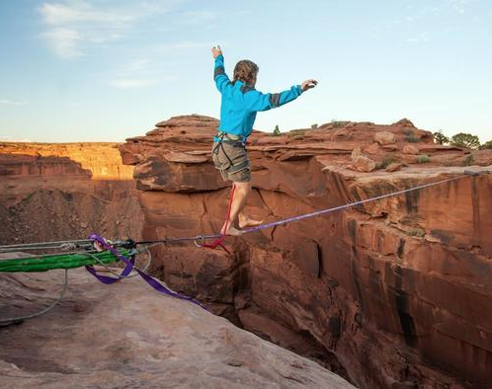
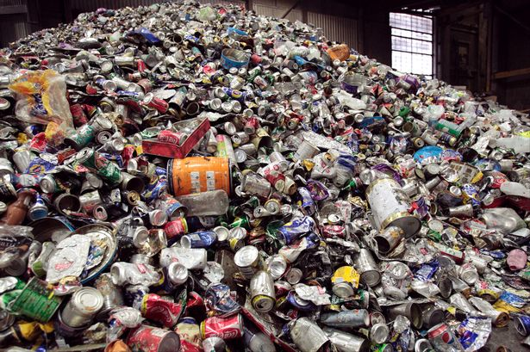
Hazardous
Risky
Refuse
Rubbish

Slide 9
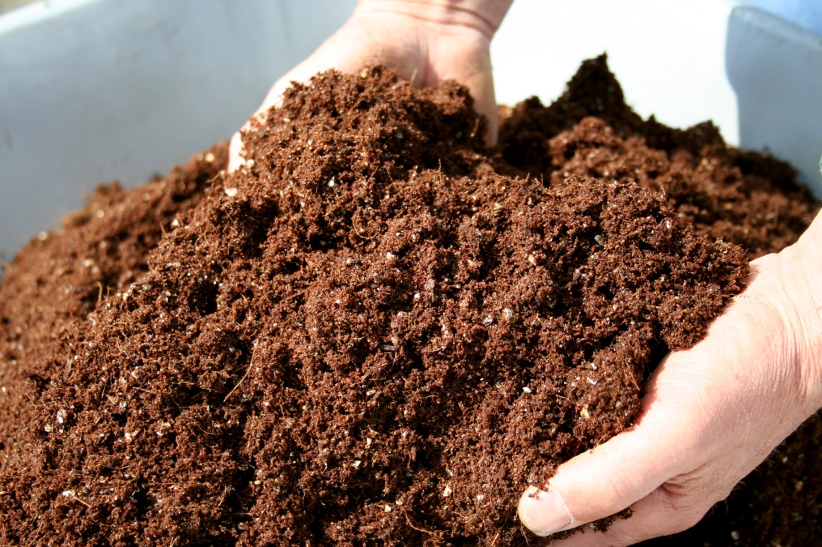
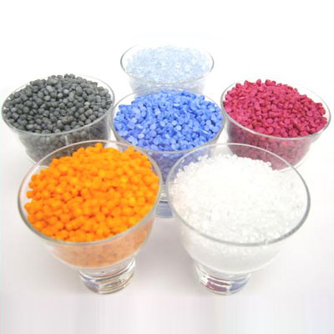
Compost
Natural fertilizer
Materials
Things

Slide 10
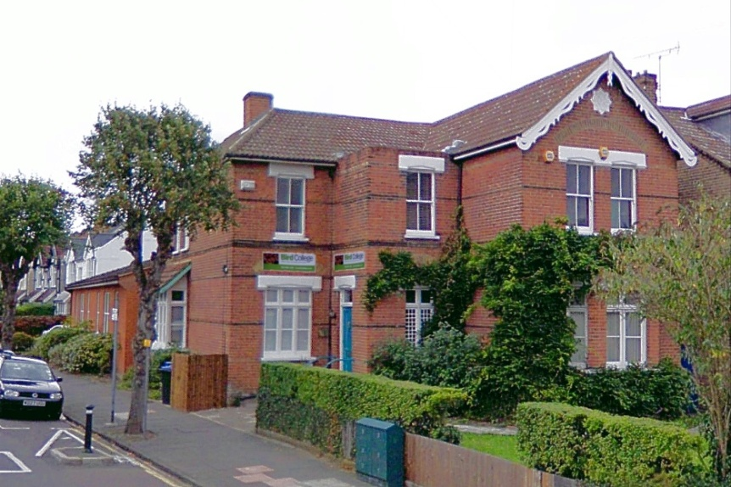
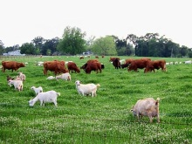
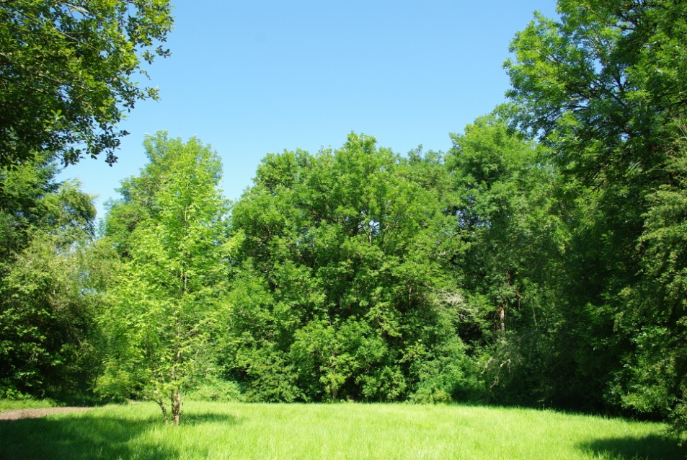
What is Environment?
Environment is a combination of -
House
Animals
Trees

Slide 11
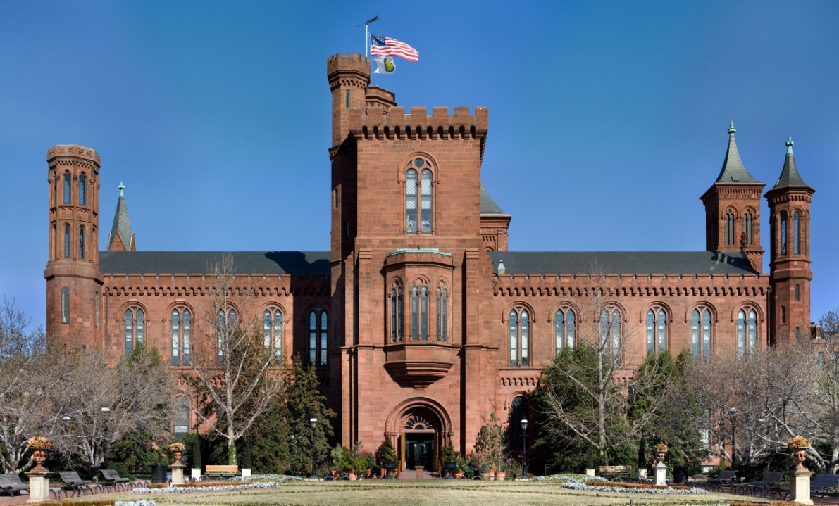
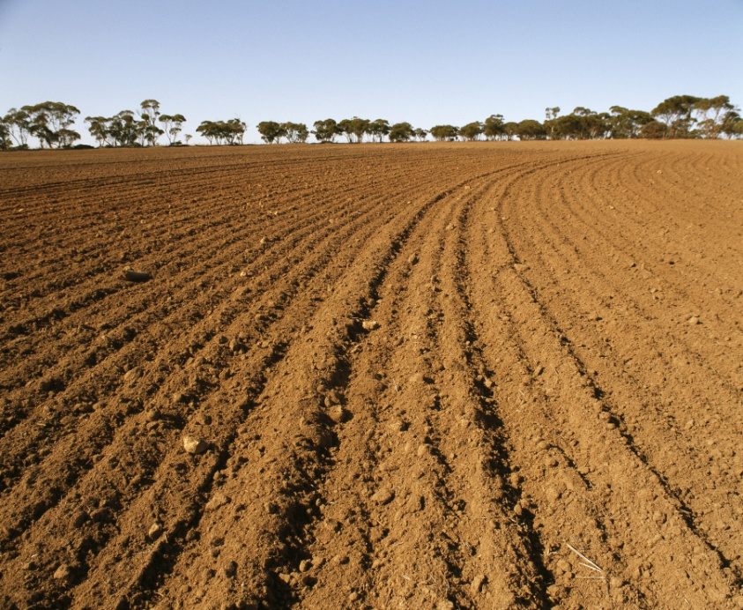
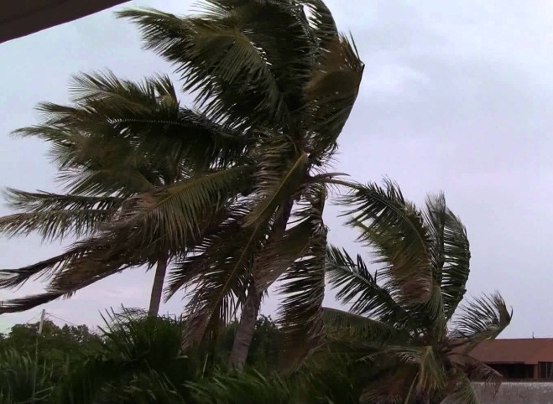
Institution
Soil
Air

Slide 12
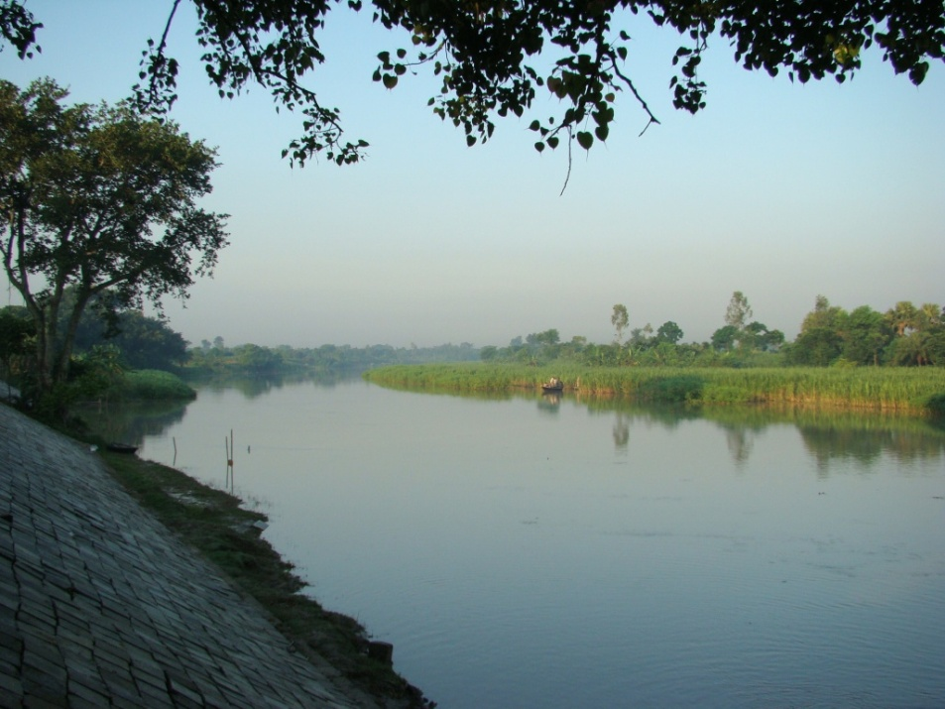
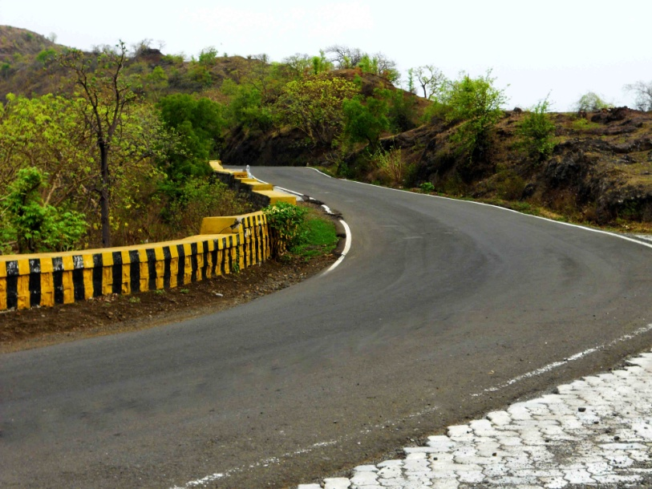

River
Roads
And water

Slide 13
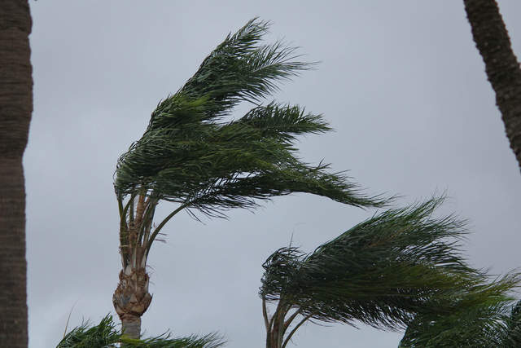

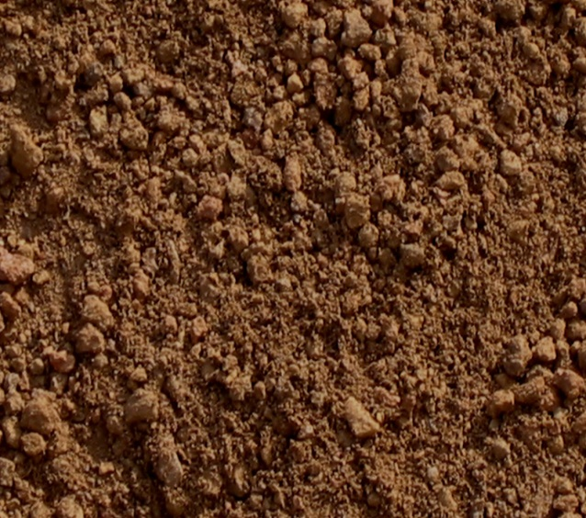
Which elements are important among them?
Among them-
air
water
soil
Are the main elements of the environment.

Slide 14
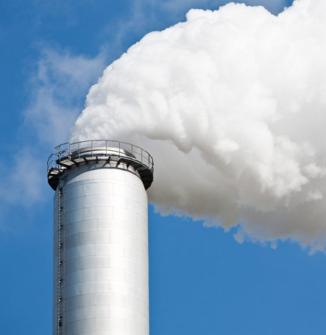
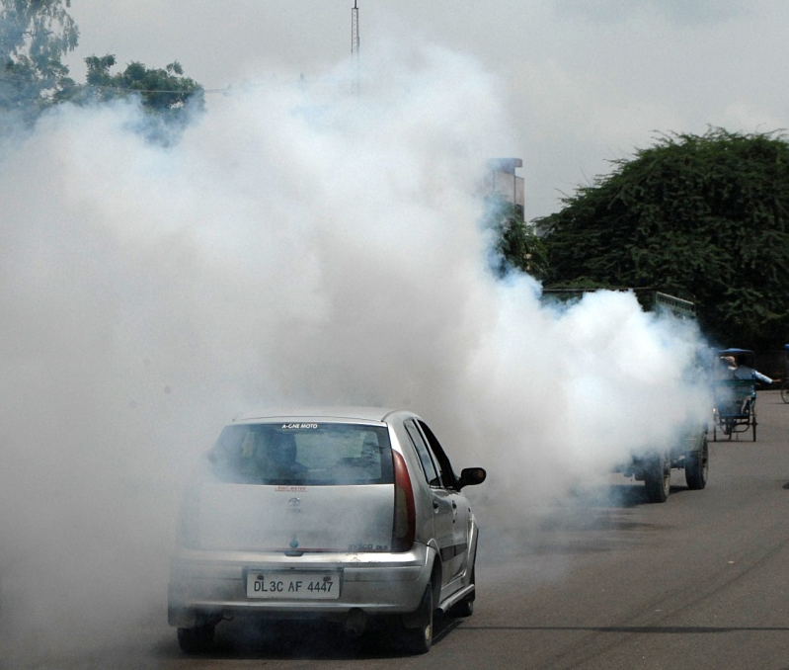
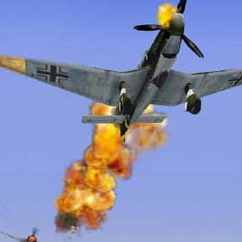
These are the main elements because-
In Bangladesh brick kilns,old or poorly serviced vechicles,burn fuels,that creat smoke and smoke is mixed with air and air is polluted.

Slide 15
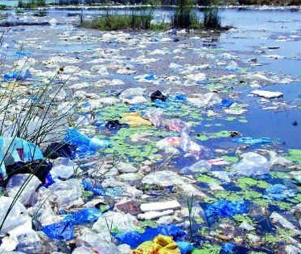
Secondly,Water pollution is another problem that we are Fatching .Sea and river is being polluted by industrial waste throw in it.

Slide 16
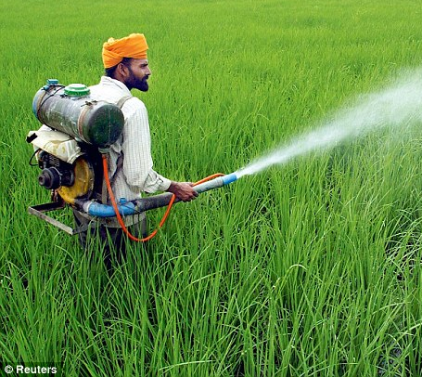
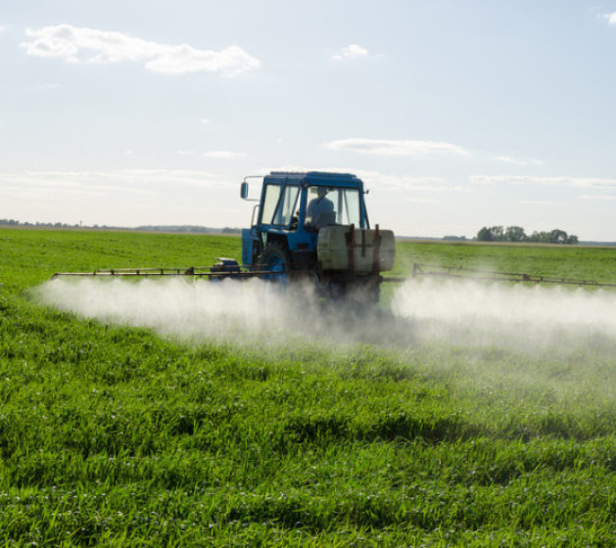
Pesticides and chemical Fertilizers used by the farmers are washed away by rain water and mixed with rivers and pond water.

Slide 17
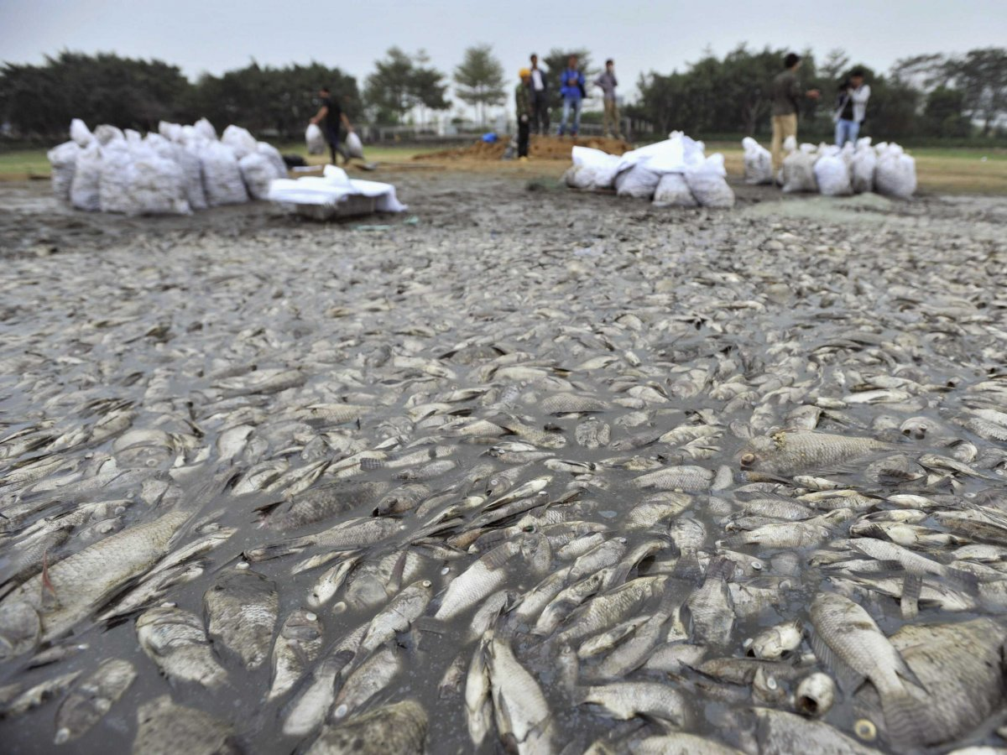
So,existence of aquatic animals and plants is becoming risky.

Slide 18
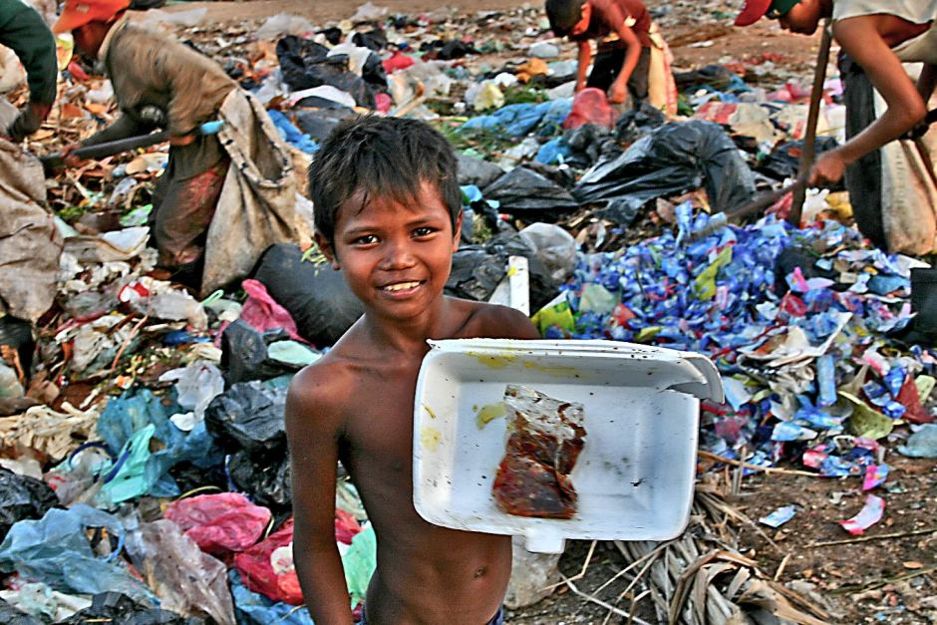
Among the most significant causes of soil pollution is the enormous volume of industrial waste.

Slide 19
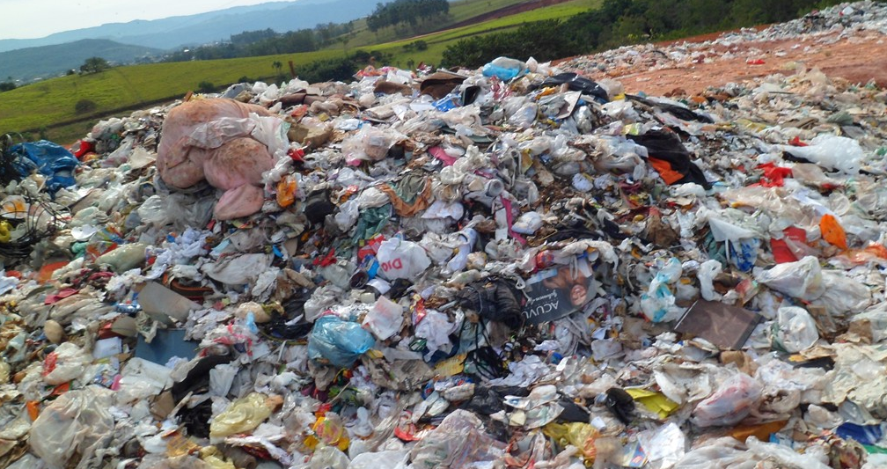
The polybags mixup with soil and destory its fertility.As a result plants and crops cannot grow well.

Slide 20
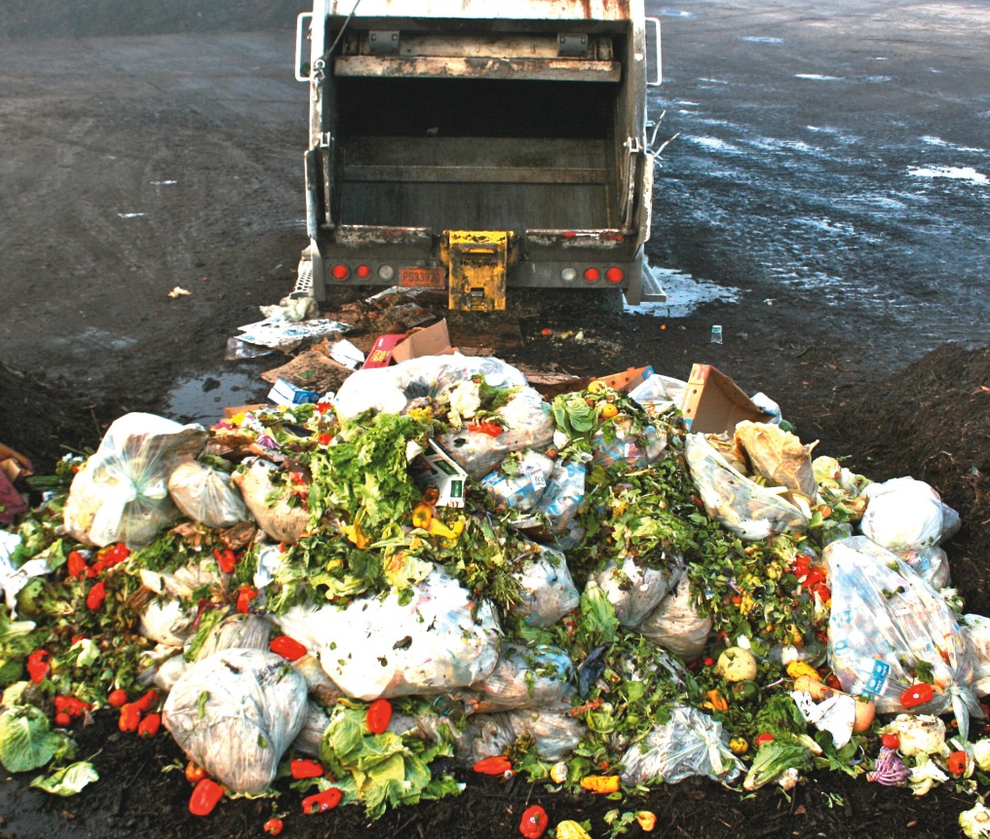
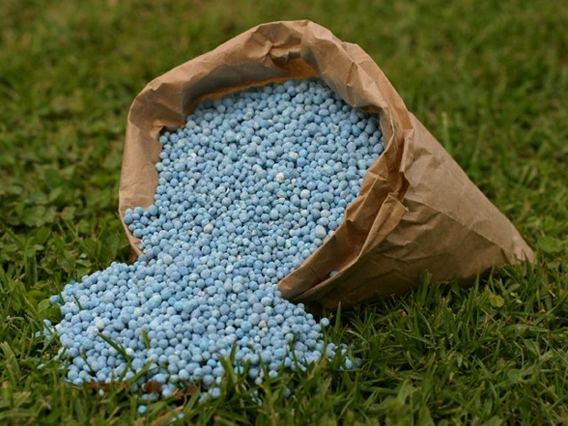
The mismanagement of household wastes,use of fertilizers is the another cause for soil pollution.

Slide 21

Single work
Do you know about any more pollution?If know write a summery on it basis on text.

Slide 22

What do these cause?
All this cause a serious negative impact on our existence.

Slide 23
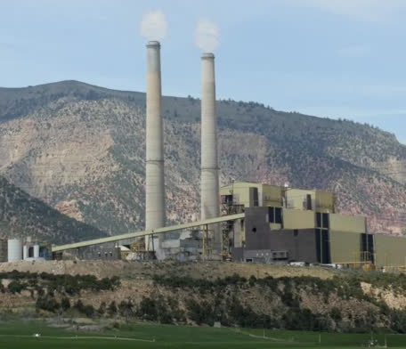
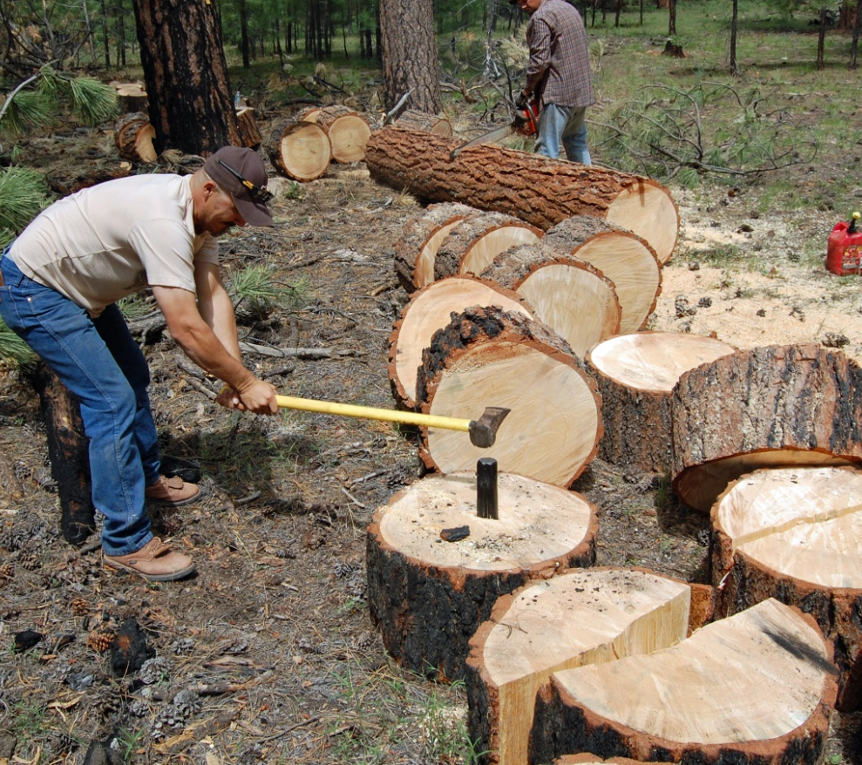
In order to stop these pollution we should take some steps.We should control the burning of-
Fuels,stop cutting trees at random

Slide 24
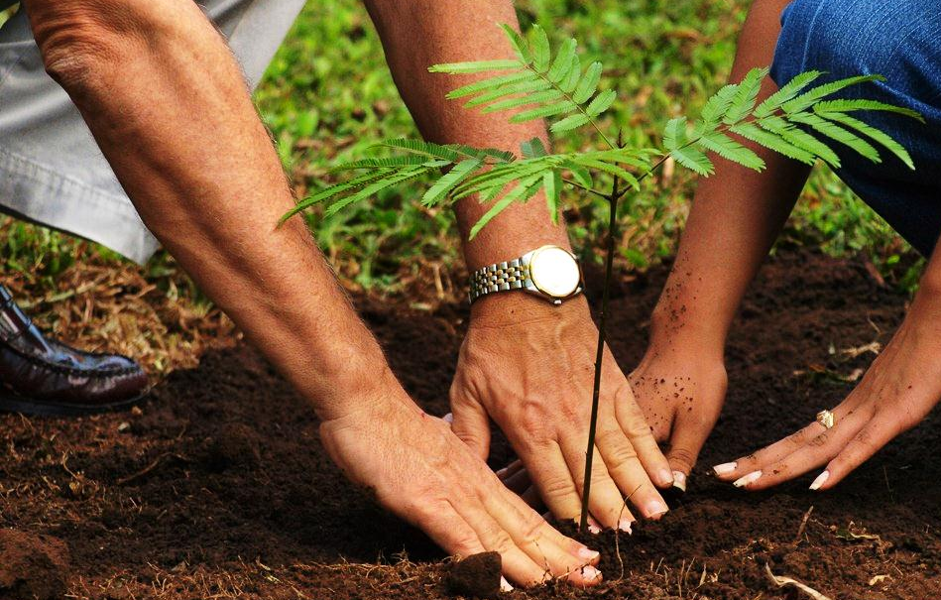
Plantng more trees regularly.

Slide 25
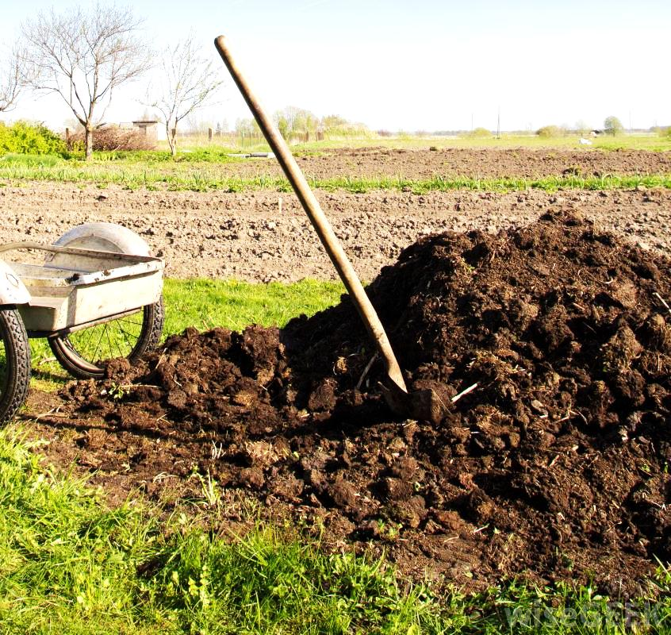
using natural fertilizer instead of chemical fertilizer

Slide 26
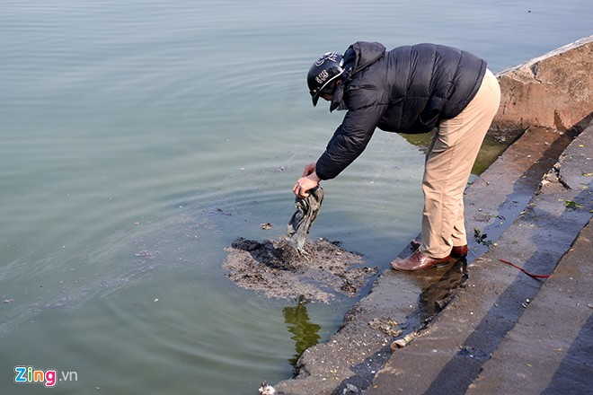
and stop throwing waste materials in the rivers and canals

Slide 27
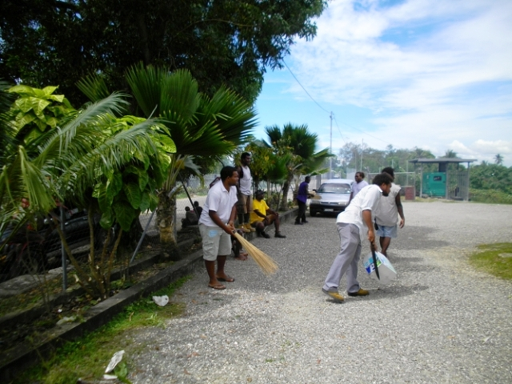
and after all we should keep our environment clean.

Slide 28
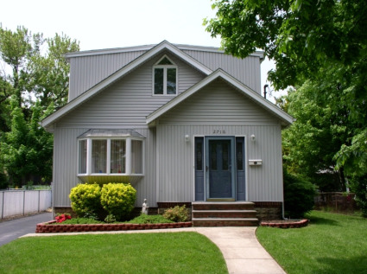
If we can do so ,we are sure to ensure a happy and peachful environment.

Slide 29
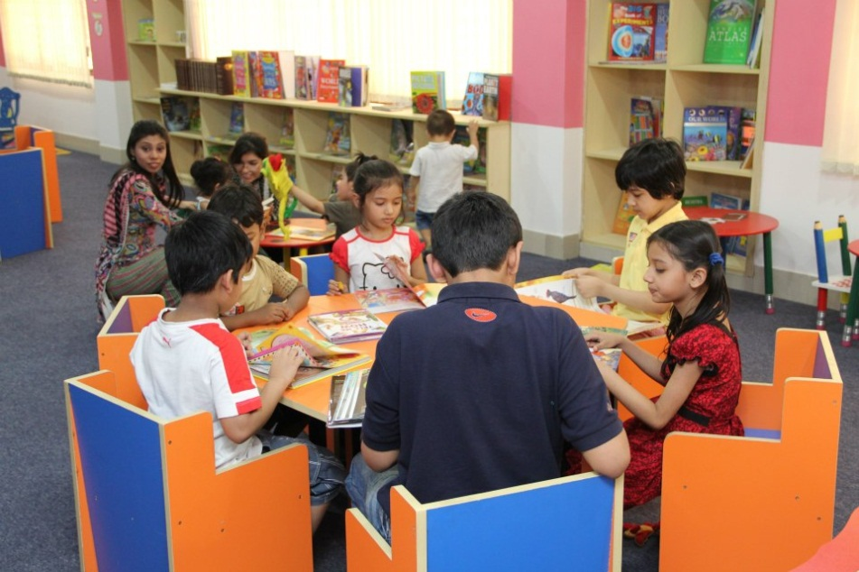
Group work
Group- A
Group- B
Write 5 stypes of pollution causes.
How can you prevent pollution.

Slide 30

Evaluation
Fill in the gaps with the clues-
burning
brick
ten
fuel
reuse
jute
Recycle
Pollution | CAUSES | suggestions
Air pollution | 1.Toxic smokes from …………..…..plants 2.Smoke from the……………..fields | 1. Don’t drive motorcars which are older than………..years
 |  | Use CNG or LP gas as car……………………
Soil pollution.. | Industrial wastes not……………properly Use of……………shopping bag | 1………..……paper , plastics and other materials

Slide 31


Write a short paragraph about”Environmental pollution”.

Slide 32


